Slide 1
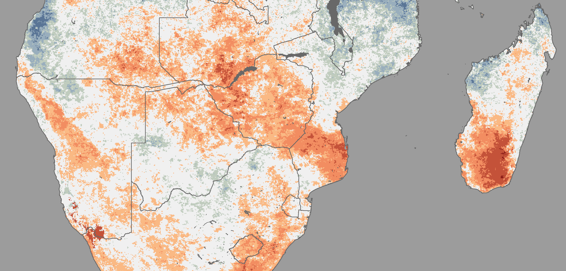
A Combined Drought Index: Concept and Practice
Geospatial and Remote Sensing Unit, Analysis, Planning and Performance Division, WFP-HQ

Slide 2
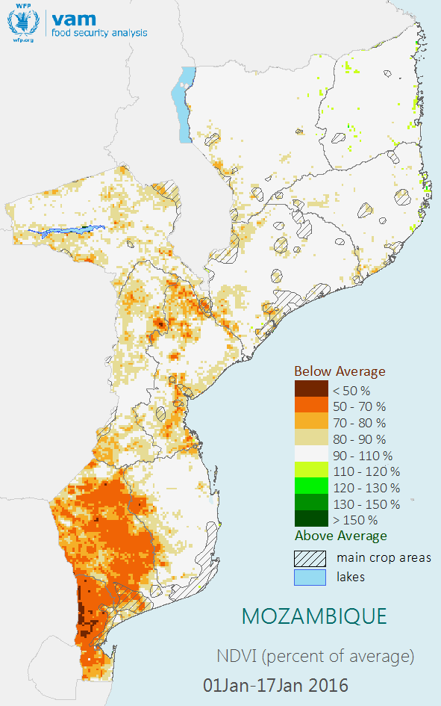
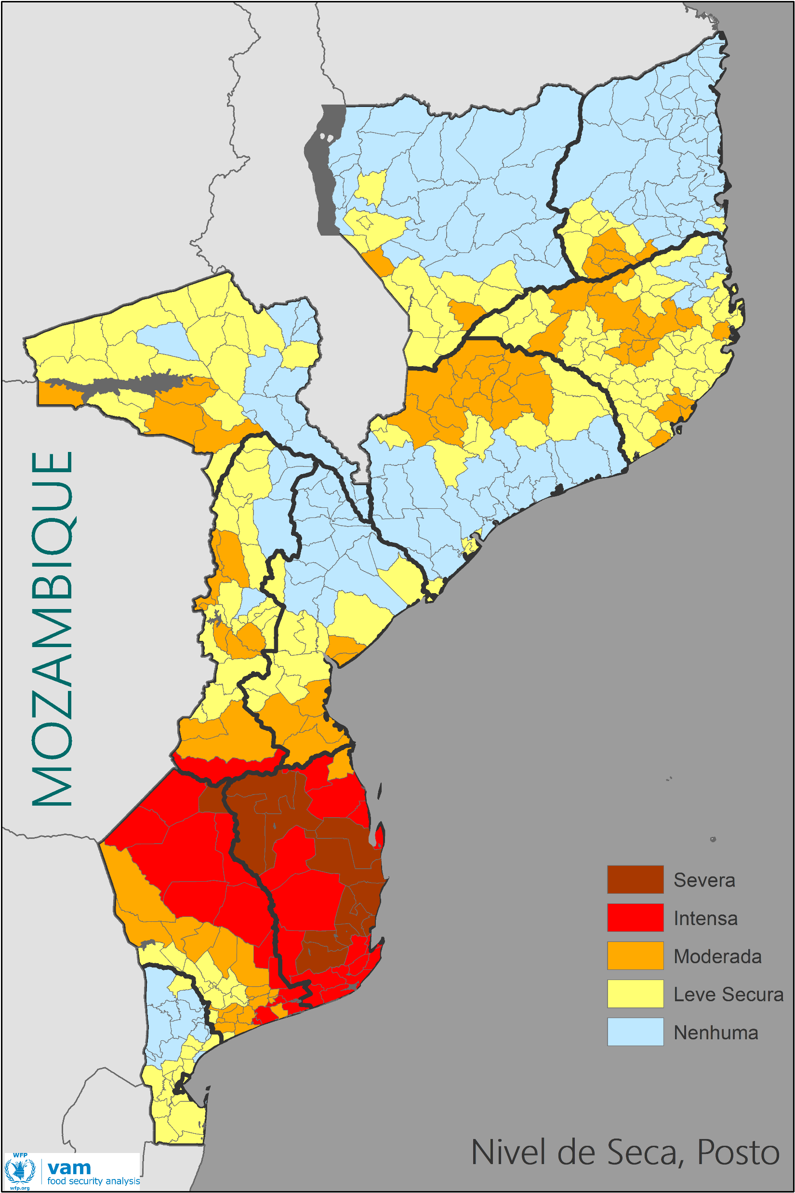
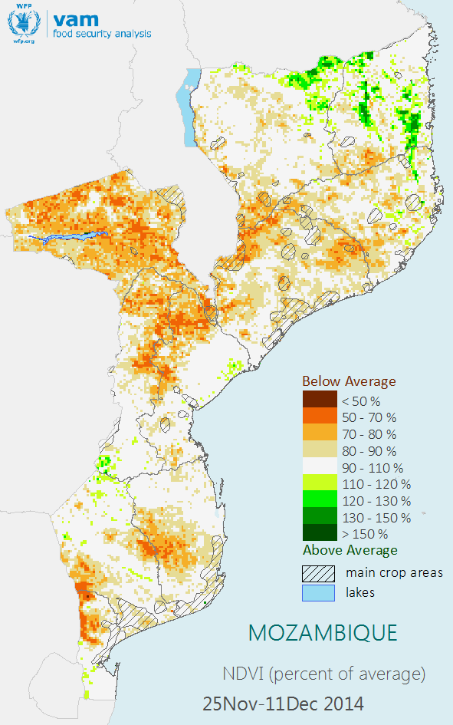
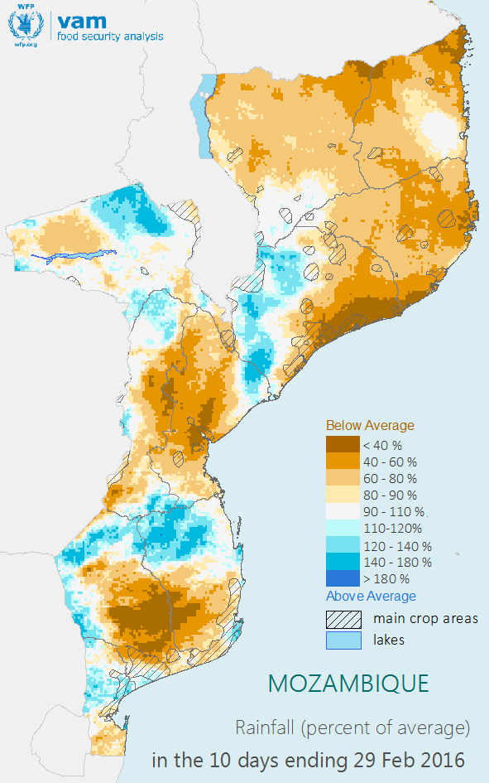
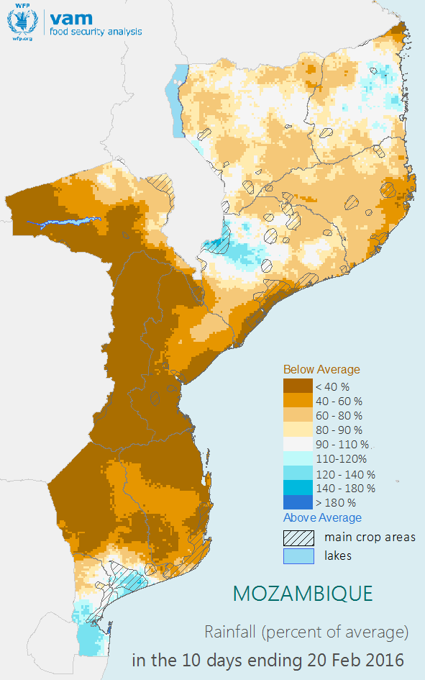
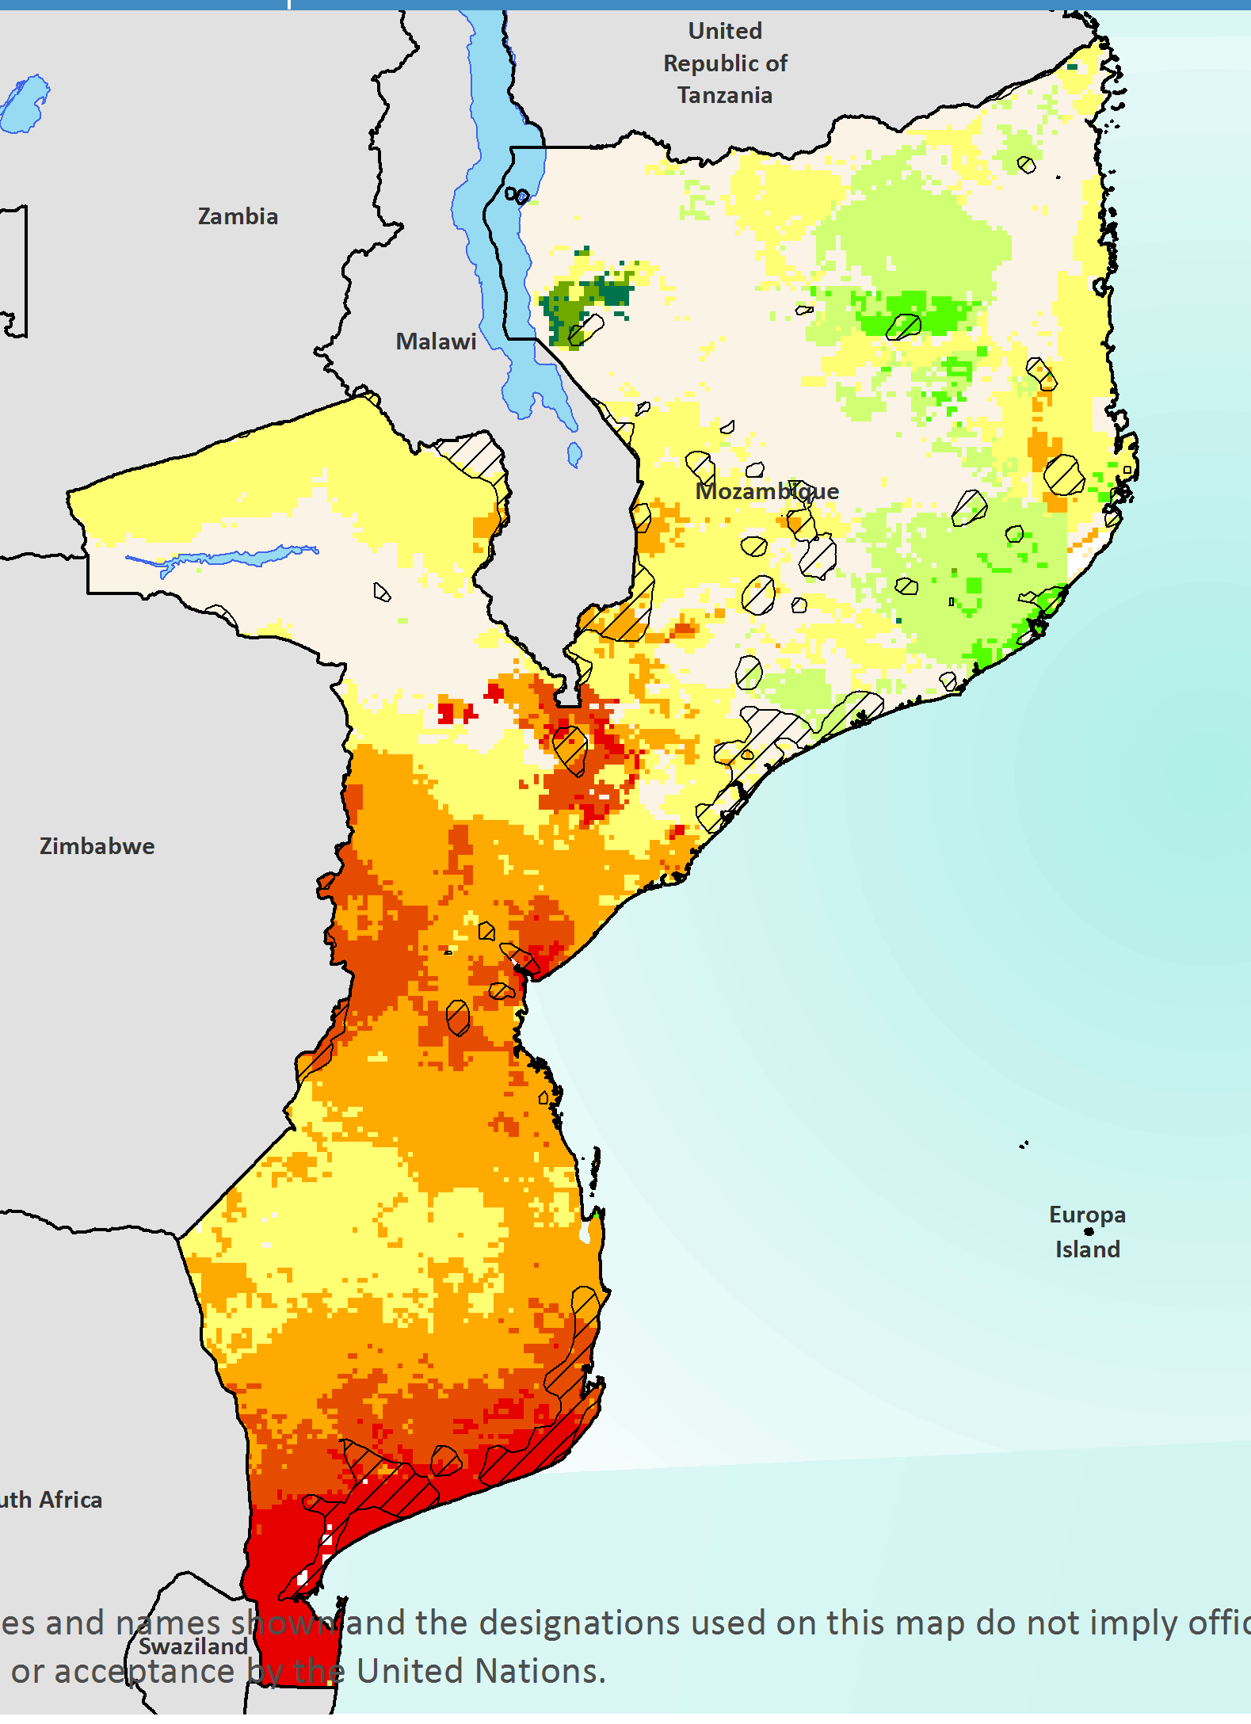
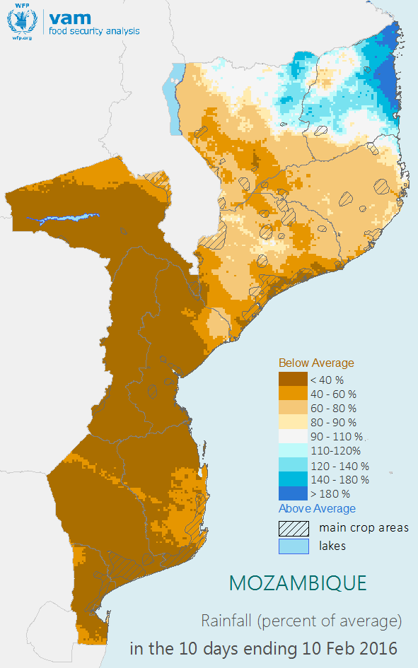
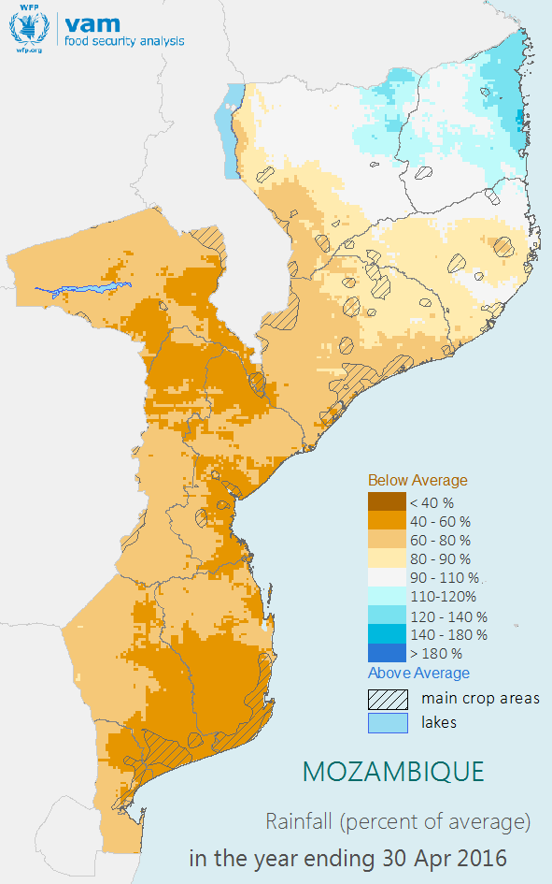
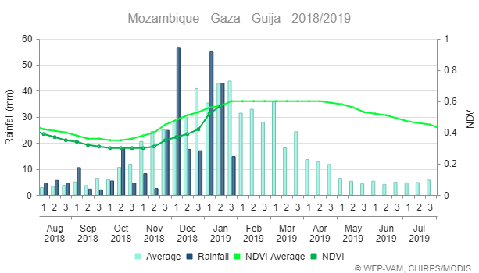
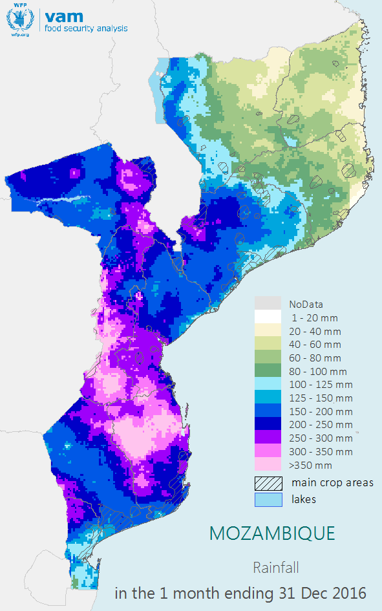
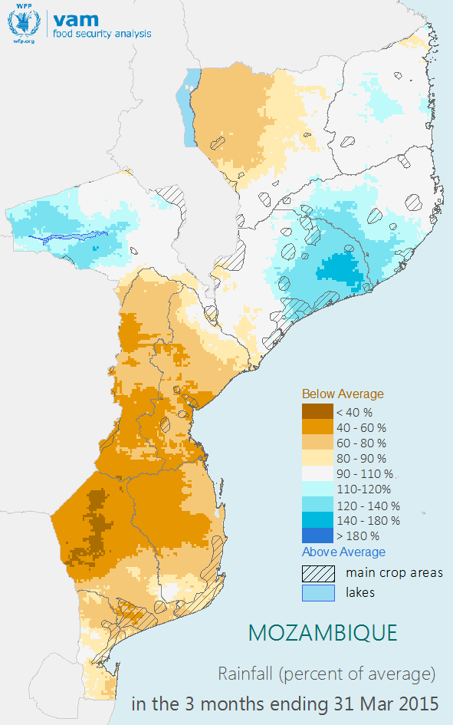
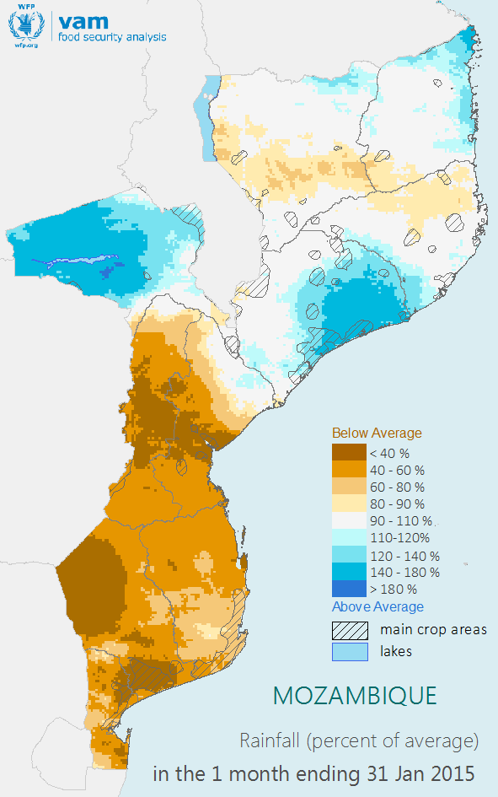
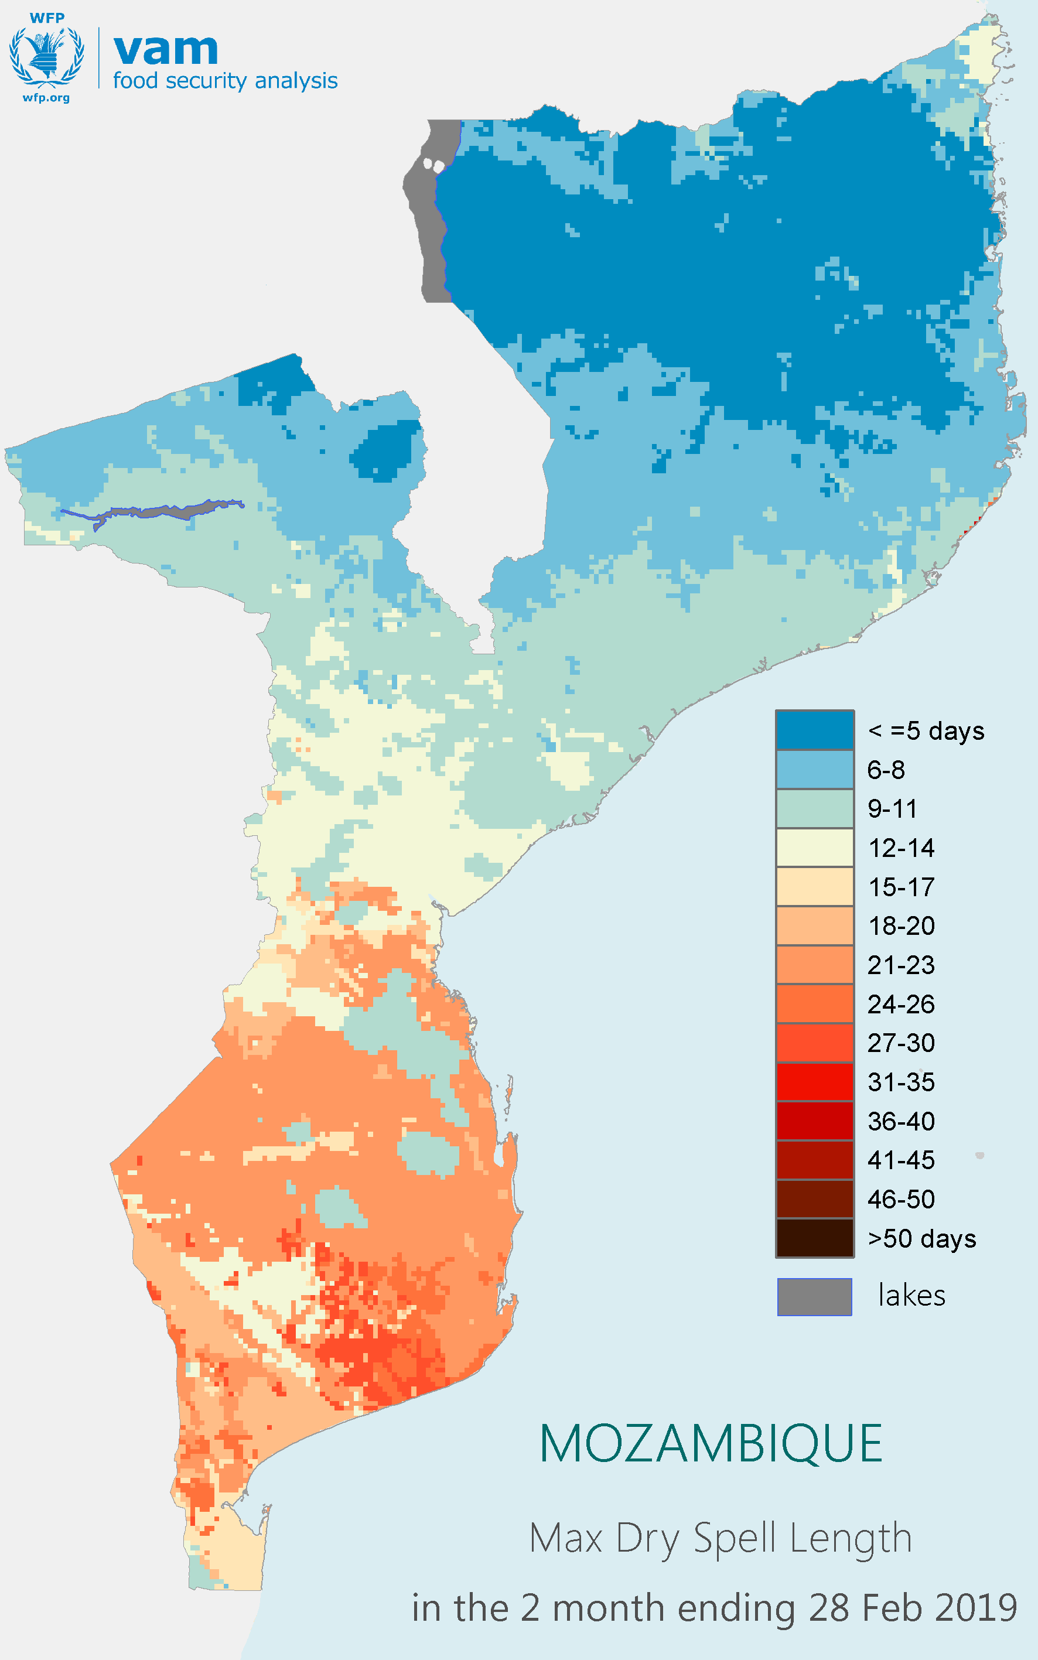
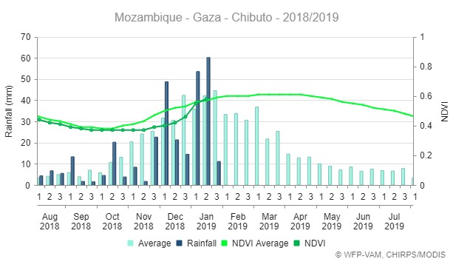
Motivation
While drought is a very complex phenomenon, decision makers and the general public require a simplified way to identify areas that have been most affected by a drought event.
Multiple indicators / variables
Top level Indicator
Combine multiple variables into a Drought Index
Analysts
Decision Makers

Slide 3
Motivation
Objective:
An Index that conveys the performance of the growing season in an easy-to-understand numerical scale, e.g. 0-100.
The proposed index is built on the key variables of the water cycle available as gridded variables:​
Rainfall
Reference (potential) evapotranspiration
Soil moisture.
Rainfall representing water availability, reference evapotranspiration representing water demand and the soil moisture stored water.

Slide 4
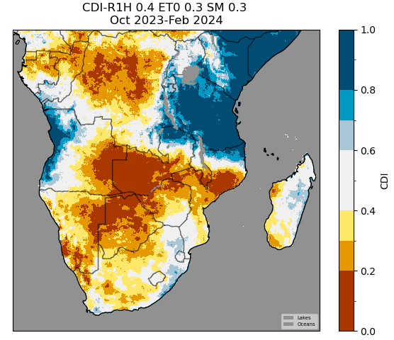
Motivation
The index should be available for each time step of the growing season representing the combined state of the water variables at that moment along the season.
It should also be available as an integrated amount over a number of time steps or the full season.

Slide 5
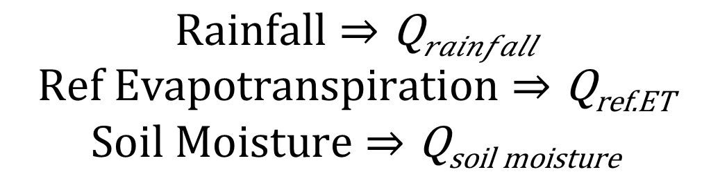
Calculation
The index is derived using a monthly time step.
The monthly time step variables are converted to an anomaly, i.e. a measure of how far from the “usual” their values are. This is built from information for the specific month for which the anomaly is derived.
$$\begin{aligned}Rainfall⇒\text{Q}\text{rainfall} \\ \begin{aligned}Ref Evapotranspiration⇒\text{Q}\text{ref}\text{.}\text{ET} \\ Soil Moisture⇒\text{Q}\text{soil} \text{moisture}\end{aligned}\end{aligned}$$
Which anomaly should we choose? The two obvious candidates:
Percentiles and Standardized Anomalies.

Slide 6
Calculation
Both convey where the variables “sit” in the historical distribution of values.
Percentile: In a scale of 0-100, where 0 = lowest, 50 = midpoint, 100 = highest
Standardized Variable: distance from mean in standard deviations [-4 to +4]
The percentile (noted Q) is preferred as the 0-100 scale is easier to understand by non specialists.
CDI = 𝑓(Q_{𝑟𝑎𝑖𝑛𝑓𝑎𝑙𝑙} , Q_{ref.ET} , Q_{soil moisture}) (1)
The monthly value of the index is then derived by combining these percentiles.

Slide 7
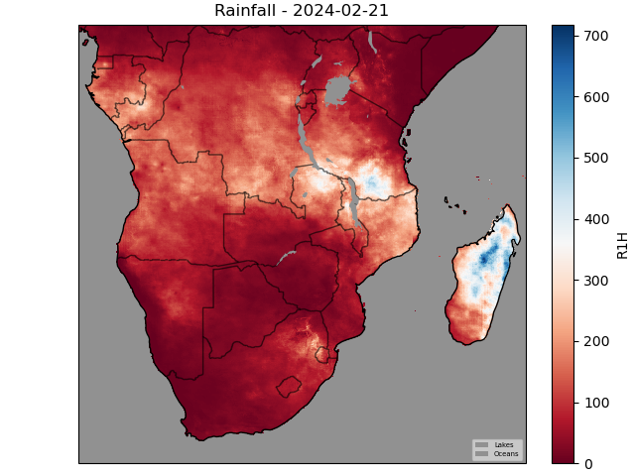
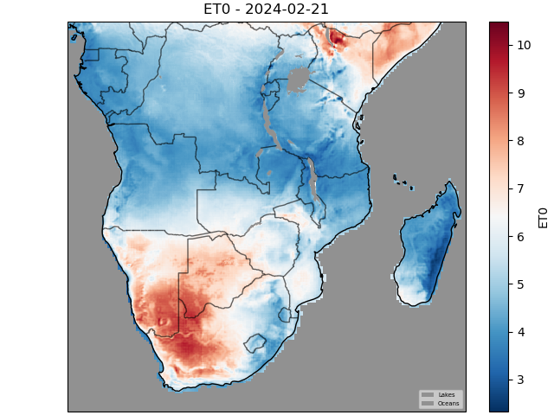
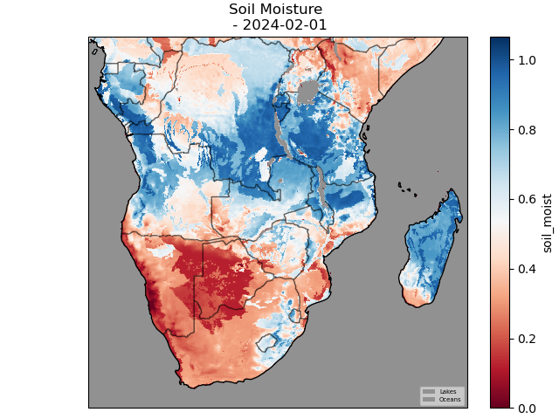
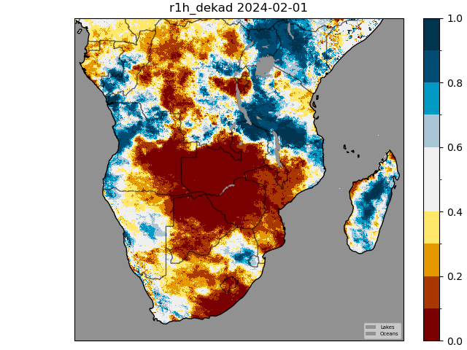
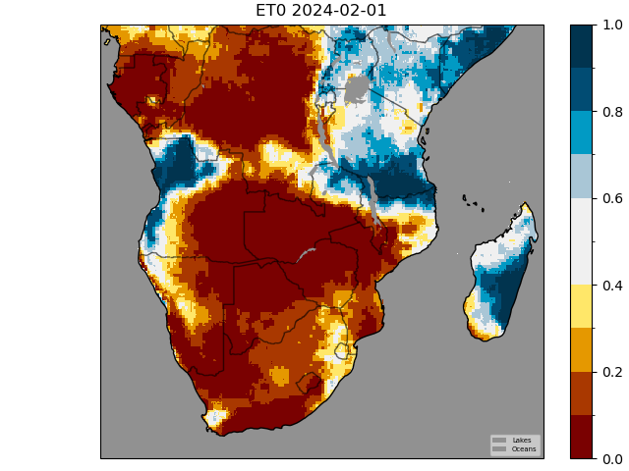
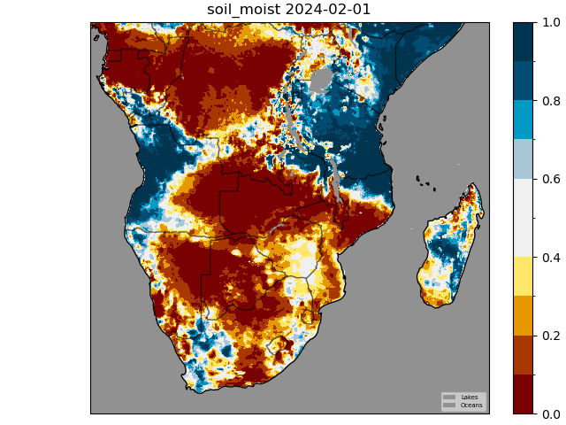
Calculation
Rainfall
Ref ET
Soil Moisture
Individual variables for Feb 2024 converted to Percentiles

Slide 8
Calculation
How do we combine these percentiles? Simplest is to use a weighted mean of the percentiles. Percentiles can’t be averaged directly, they have to be transformed to logits:
𝜃rainfall = 𝑙𝑜𝑔𝑖𝑡 ( Qrainfall) l𝑜𝑔𝑖𝑡(Q)=𝑙𝑛 (Q/(1−Q))
Repeat for other variables, then weighted mean:
𝜃 = ∑ 𝑤_{𝑖} ∗ 𝜃_{𝑖}
The weights (which add to 1) are importance weights and reflect the relative importance we attach to each variable. Currently we have:
Wrainfall = 0.4
WrefET = 0.3
Wsoil moisture = 0.3
Rainfall is weighted more since it is the driver variable and is derived from actual observations, the other two being modelled estimates

Slide 9
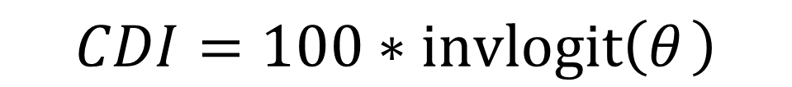
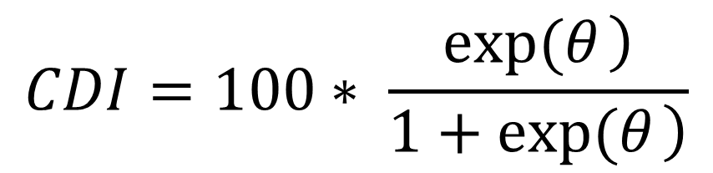
Calculation
Once logits are combined, we have to go back to a 0-100 scale, because that is how we convey the performance of the variables.
We do this using the inverse logit function.
$$CDI=100∗invlogit\left(θ_{ }\right)$$
$$CDI=100∗ \frac{\left.exp(θ_{ }\right)}{\left.1+exp(θ_{ }\right)}$$

Slide 10
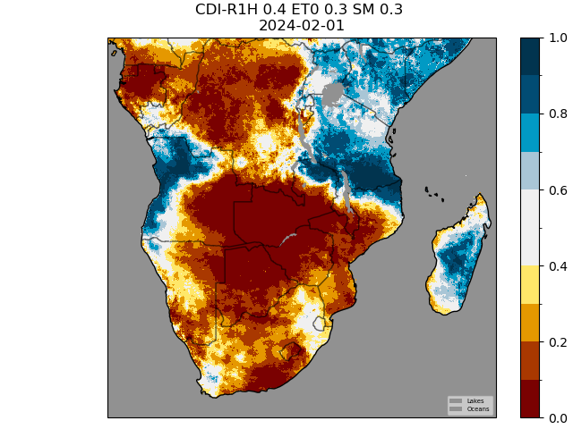
Calculation
Rainfall
Ref ET
Soil Moisture
Weighted Logit
Logit Rainfall
* 0.4 +
Logit RefET
* 0.3 +
Logit SM
* 0.3 =
CDI February 2024
InvLogit

Slide 11
Seasonal Index

Slide 12
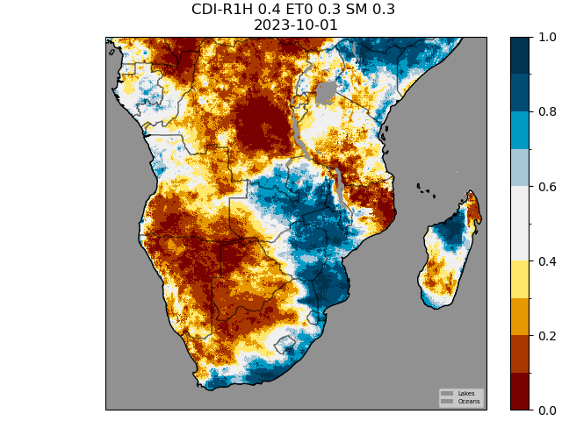
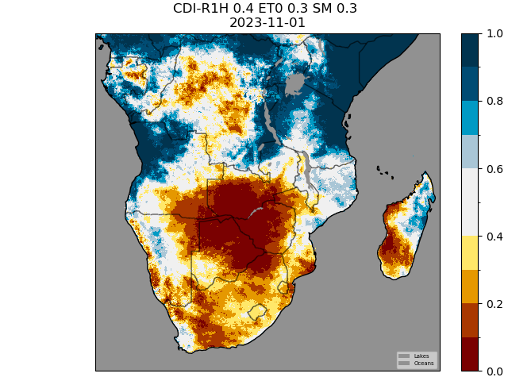
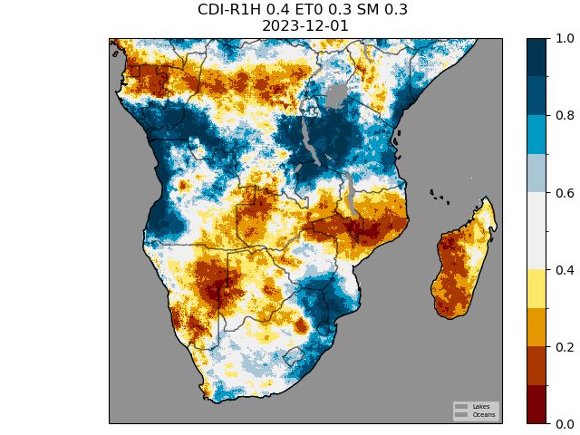
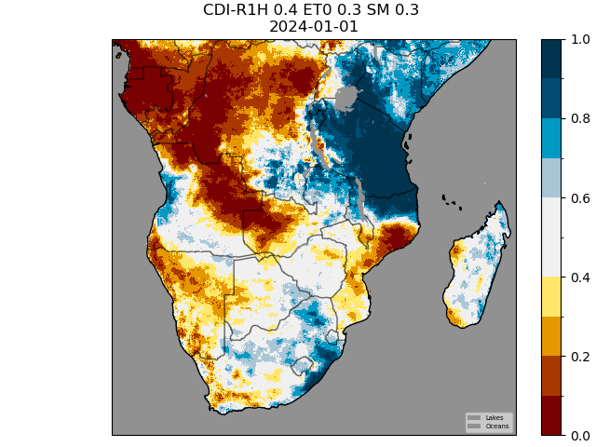
Seasonal Index
Once we have the monthly CDIs, how can we form a seasonal CDI?

Slide 13
Seasonal Index
The interest is to derive a seasonal CDI, that can translate the performance of the whole season to date, and not just at a specific point in time.
We integrate the monthly CDIs through the season, using time varying monthly weights.
The seasonal weights S should reflect the importance of each month in the rainfall season. E.g. February is more important than October.

Slide 14
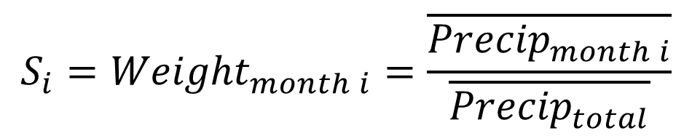
Seasonal Weights
The seasonal weights reflect the contribution of each month to the growing season. A simple way to define them is:
$${S_{i}=Weight}_{month i}=\frac{\overline{{Precip}_{month i}}}{\overline{{Precip}_{total}}}$$
They are derived from the long term mean rainfall and are the proportion of the seasonal rainfall that (on average) falls in each month. The weights always add to 1.
“Seasonal rainfall” is the rainfall for the whole season (Oct-Apr for Mozambique) or for any period the user is considering (like a shorter season to date, Oct-Feb, or a three-month period like JFM. Pixel level seasons can be considered as well.

Slide 15
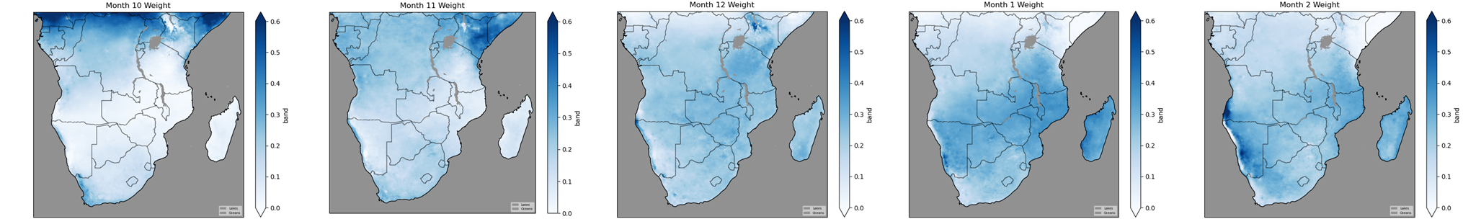
Seasonal Weights
In the context of Southern Africa, October contributes a much smaller amount to the index compared to February, since February is a much rainier month. All calculations are pixel based, so this scheme accounts for the variability in rainfall seasonality that may exist across the region.
Southern Africa Monthly Weights October - February

Slide 16
Seasonal Index
𝜃CDI month i = 𝑙𝑜𝑔𝑖𝑡 ( CDImonth i)
𝜃_{seasonal}= ∑ s_{𝑖} ∗ 𝜃CDI month i
$$\text{CDI}\text{seasonal}=100∗invlogit\left(θ_{seasonal }\right)$$
The weighted sum of the monthly CDI is done through a Logit / InvLogit conversion

Slide 17

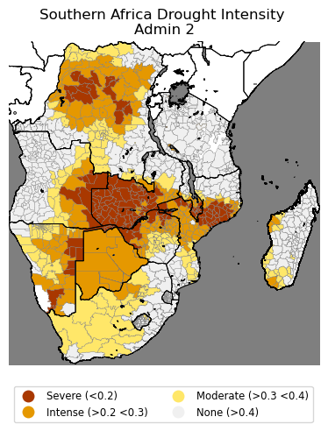
Practical Applications

Slide 18
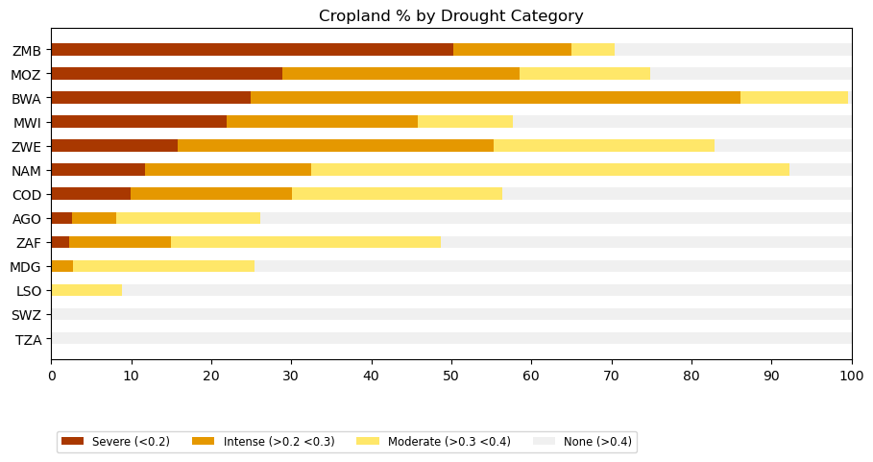
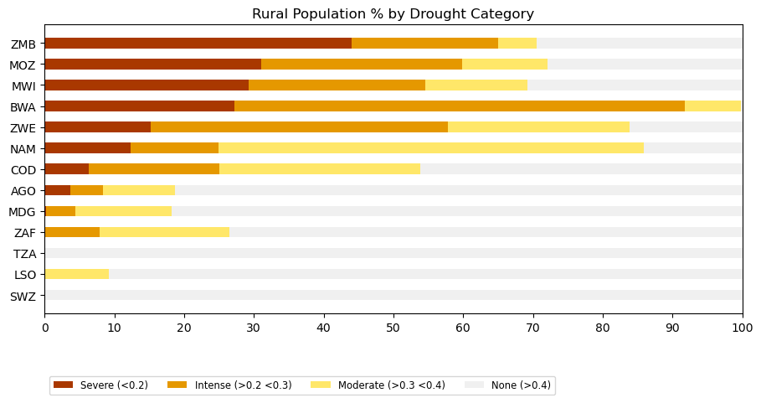
Practical Applications

Slide 19
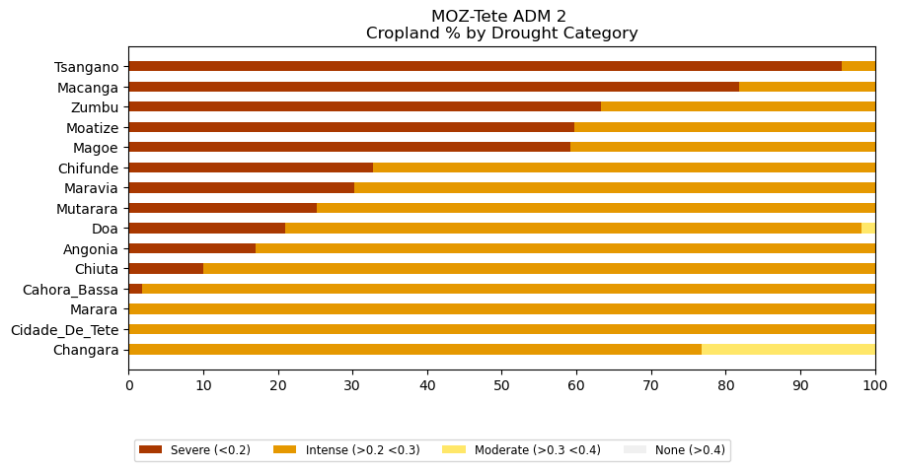
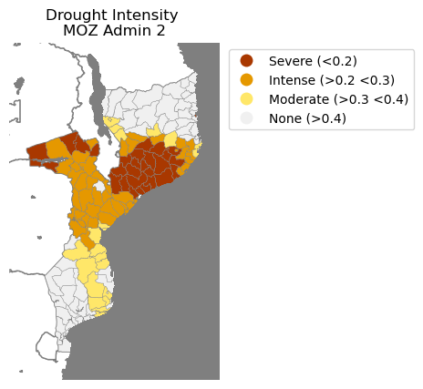
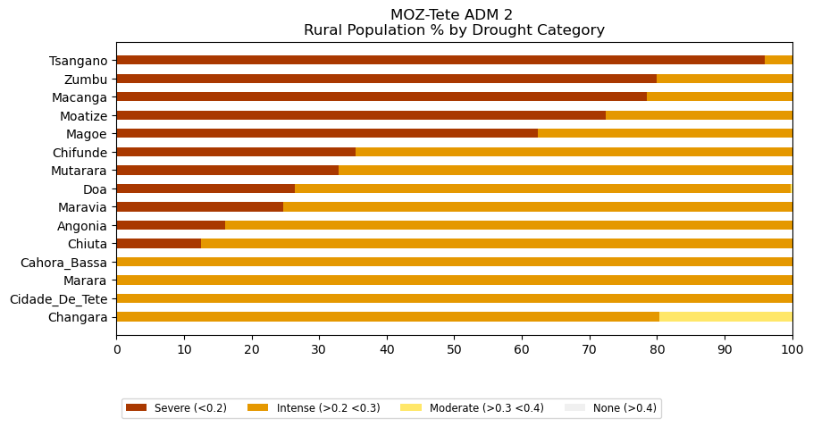
Practical Applications

Slide 20

vam
food security analysis

